Slide 1

Instructional Leadership Program Administrative/Supervisory Concentration(ASC)
Notes:
Welcome! Thank you for your interest in the instructional leadership program at Utah State University. We are looking for great people who would like to make an impact in instructional leadership. We hope this short video is helpful in providing information about our program.

Slide 2
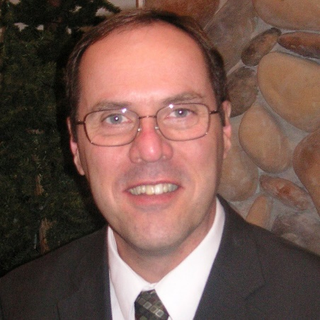
Contact Information
Greg Lewis, PhD
Instructional Leadership
School of Teacher Education and Leadership
Utah State University
greg.lewis@usu.edu
435-797-3912
801-940-7216 (cell)
Notes:
My name is Greg Lewis and in addition to being one of the program instructors, I help advise students in the program. After viewing this introduction to the program, please feel free to contact me with any questions you may still have.

Slide 3
Why Get an Administrative License?
Make a difference for the greatest number of students
Become an expert in the field that you love
Long-term investment in your earning potential
Career advancement opportunities

Slide 4
Why Choose USU
Quality: US News & World Report ranks USU in the top 30 Graduate Schools of Education in the country.
Affordability: GradSchoolHub ranked our master’s program number one in the country after adjusting for cost.
Flexibility: Our programs are for the working professional. For most classes you attend class from your home computer.

Slide 5
Pathways to a degree and/or licensure:
MEd in Instructional Leadership—a master’s degree and an administrative license
Administrative/Supervisory Concentration (ASC)—Administrative Licensure only
PhD in Instructional Leadership—earn a doctorate with a focus on research
EdD in Instructional Leadership—achieve a doctorate with a focus on solving educational leadership problems
Notes:
The Instructional Leadership program at Utah State offers four options:
Option 1: For those who do not already have a master’s degree or their degree in in an area that is not recognized by the Utah State Board of Education. With the addition of four core classes from the graduate school, students can earn a master’s degree and be recommended for their administrative license.
Option 2: The Administrative/Supervisory Concentration or ASC is for those individuals who already have a master’s degree in an education related field from an accredited university and are completing the program to receive their Utah Administrative License. We sometimes call this the license only option.
Option 3: The Instructional Leadership program also offers a PhD in instructional leadership. This program allows students to earn a doctorate with a focus on research in the field of leadership.
Option 4: Students may also earn an EdD or Educational Doctorate in instructional leadership. This is a distance education option for those who wish their doctorate to be focused on solving educational leadership problems.

Slide 6
Delivery of Coursework
Fall and Spring Semesters: distance technologies
Interactive video conferencing
Online synchronous
Online independent
Summer Semester—a mix of delivery methods:
On-line hybrid for 7 weeks with face-to-face requirement for 1week at our Brigham City campus
14 week online synchronous courses
Notes:
There are 30 graduate level credits required for the license only option. To make accessibility to the program as convenient as possible, all courses are offered three times during the year—once each semester. During the fall and spring semesters, the courses are offered in a “blended” format combining live internet sessions and independent work. For the live class sessions, students connect from home or school on any computer with internet access with the rest of the course work being done independently as in a typical online class.
During the summer semester, there is a mix of delivery options. Some courses are condensed into 7 weeks; six of those weeks will be similar to the fall and spring semesters with blended on-line assignments. One of the weeks requires the student to attend class sessions of four hours per day, face-to-face in a classroom at the USU Brigham City campus. Other courses are held online and last the full 14 weeks. The summer schedule is designed so that students will be able to make their USU schedule fit their personal schedule.
For students seeking the master’s degree, there are four additional courses to the ASC license only program. These courses are offered each semester and are either online or through the University's interactive video conferencing (IVC) system. These IVC courses require the student to attend at a designated USU distance education site. The IVC distance education sites are located conveniently at regional centers and high schools throughout the state.

Slide 7
Approximate Costs
Time: Most complete in 5 semesters for MEd and 3-4 semesters for ASC
Tuition and Fees $12,100 (approximate)
Books, travel, etc. Individual
A chart showing current tuition can be found at: https://www.usu.edu/registrar/tuition/
Financial aid opportunities can be found at: http://www.usu.edu/financialaid/
Notes:
The approximate costs of the program are shown for the license only program. The master’s degree program requires an additional 4 courses and would add approximately $4,800 more. Please note the tuition and fee costs are regularly changed after each session of the Utah State Legislature and are approved by the Utah State Board of Regents. The costs are approximate. Books, materials, and travel expenses that may be necessary are not estimated. Typically, students completing the master’s degree program would take at least one additional semester of courses.

Slide 8
Admission Requirements:
Graduate admission standards for Utah State University (for MEd)
GRE or MAT above the 40th percentile
GPA > 3.0
Three years of professional educational experience/Level II teaching license
Evidence of clearing USBE fingerprint background check
3 Letters of Recommendation (district staff, building principal, other)
Evidence of being deemed effective or higher by your district’s evaluation system
$50 application fee
Writing sample
Interview
Notes:
Eligibility for the program reflects requirements of the university and the Utah Board of Education, since the state is the one that actually grants the license. Students enrolling in the MEd program need to meet all requirements for USU’s graduate school. This includes a Graduate Records Exam or a Miller Analogies Test score above the 40th percentile along with having a GPA greater than 3.0.
The other requirements listed are documents required for recommendation for licensure by the Utah State Board of Education. There is also a small application fee, writing sample, and interview as part of the admission process.

Slide 9
ADMISSION INFORMATION
Applications will be considered for each semester.
Admission is competitive and limited.
Candidates who are not admitted may be considered for a later semester.
Notes:
Applications for the program are considered as they are submitted. We do limit the admitted enrollment for each semester to ensure courses will be available to students. If the number of applicants exceeds the available admission slots, individuals may be considered for admittance in a future semester without additional costs for application. A new cohort begins each semester.

Slide 10
ADMISSION DEADLINES
Applications are reviewed and candidates accepted each semester
Spring semester apps are due in October
Summer semester apps are due in March
Fall semester apps are due in July
Notes:
As applications are received, the content information is reviewed. Letters of recommendation are reviewed and rated. The writing sample submitted as part of the application is reviewed and rated. A telephone interview is scheduled, held, and rated. All of the ratings are then considered and individuals are informed of their admittance status. Individuals that are admitted are invited to an online session with the program advisors, and then they are cleared to register for classes.

Slide 11
Advising
Instructional leadership program only students: Dr. Greg Lewis, Administrative Supervisory Area of Concentration Program Coordinator
Master’s degree students: Dr. Courtney Stewart, Instructional Leadership Concentration Masters of Education Coordinator
Notes:
Advising is provided by Dr. Greg Lewis and Dr. Courtney Stewart as indicated.

Slide 12
Transfer Credit
No more than 12 semester credit hours from another accredited higher education institution.
At the time of admission, a program of studies will be established which acknowledges any transfer credit.
Notes:
In some situations, applicants for the program have taken graduate level courses from accredited institutions that are so similar to our courses that we can give credit for the course. Such credit cannot be over 8 years old by the time the individual would complete our program, and we cannot accept more than 12 semester credits from previous coursework. Individuals who feel their previous graduate work may meet some of the requirements of our program may request an evaluation of their transcripts by the appropriate program advisor. The program course of studies completed by the individual and the advisor will outline the student’s plan for completing the program and recognize any transfer credit accepted, should there be any.

Slide 13
PROGRAM STANDARDS
This program is guided by:
The requirements of the Utah State Board of Education (R277-505. Administrative License Areas of Concentration and Programs), and
The Utah Educational Leadership Standards, based on the Utah Educational Leadership Standards and the Educational Leadership Policy Standards: ISLLC 2008, adopted by the National Policy Board for Educational Administration
Notes:
The instructional leadership program at USU is guided by the requirements established by the Utah State Board of Education for programs preparing school leaders. The USU program prepares prospective school leaders according to the Utah Educational Leadership Standards, which are modeled after national standards developed by school leadership consortia from across the nation.

Slide 14
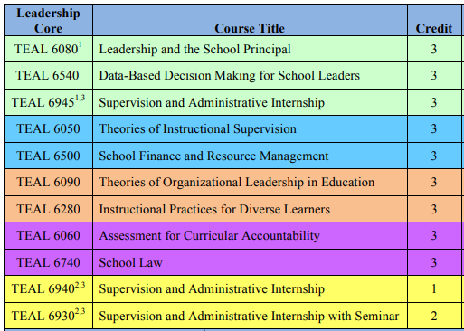
Program of Study
Notes:
For the ASC or licensure only program, there are 11 courses totaling 30 credits. This planning guide is on our website and lists a recommended pace with each color representing a semester of study. Most ASC students complete the program in 3-4 semesters.

Slide 15
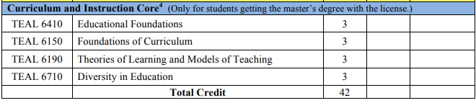
MEd Courses
Notes:
This chart lists the four additional core courses that master’s students are required to take. Most master’s students complete the program in 4-5 semesters.

Slide 16
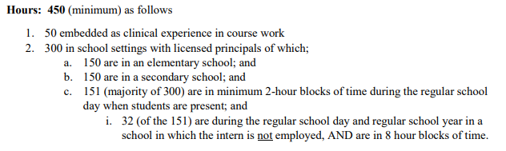
Internship Criteria: USOE
Notes:
The internship requirements are set by the Utah State Board of Education through the Utah State Office of Education. Internships must consist of a minimum of 450 hours. At least 300 of those hours must be completed in a situation where the intern is working with licensed teachers and school principals. Of the 300 hours, 151 must be completed in two-hour blocks during the regular school day. This is the most difficult part of the internship requirement for working professionals. Of the 450 hours of internship, 150 must be completed at a level (elementary or secondary) opposite the level at which the individual is currently employed.

Slide 17
Internships: USU specifics
Candidates identify internship locations and make arrangements with mentor principals or other appropriate supervisors, and district office personnel.
Internships involve the application of knowledge and skills learned.
50 hours of internship are embedded as practicum experiences as part of program courses
Notes:
We wish we could arrange a meaningful internship for each student in our program. However, the variability of school and district policies makes it impossible for us to do so. Each student in our program must arrange his or her own internship. (This is one of the reasons it is so important to have a letter of recommendation from your principal and a senior administrator in your district office.)
At USU we believe strongly that internships should involve the application of knowledge gained in and from the courses of our program. Consequently, we have created assignments in each of our courses that engage the student in activities an individual would have as an intern. Completion of these course assignments not only count toward the grade for the course, but we have equated them with a certain number of internship hours. That is, a student completing the assignment gets a grade for the assignment AND hours of internship credit toward the total hours required. At USU we have embedded 50 (of the 450 hours of required internship) in course assignments. Furthermore, 90 of those 165 hours we feel are engaging students in just what we would hope he or she would get during an internship experience during the regular school day. So 50 of the 150 most difficult hours are earned through completion of specific course assignments.
If a student takes less time to complete one of the embedded assignment than the established number of internship hours; we still award the specified number. If on the other hand, it takes a student longer to complete the assignment than the allotted number of internship hours, students can log the additional hours on their regular internship documentation and receive full credit for those additional hours.

Slide 18
Internship Assistance
University field supervisor assigned to each student at beginning of program
Mentor principals at intern schools
Online help sessions
Notes:
When individuals begin the instructional leadership program at USU, he or she will be assigned a field supervisor to help guide the internship process. The student, the field supervisor, and the mentor principals (of the schools identified by the student) collaborate on completing the internship requirements and the necessary documentation verifying satisfaction of this important aspect of the license program. During the semesters the students register for internship (the first and last semester of the program) an online session is available for individual help; of course the university supervisor and the advisor are available at any time. Students register for 3 credits of internship during the first semester of the program; and work on accumulating internship hours throughout the time he or she is in the program, and then take an additional 1 credit of internship during the last semester in the program when all documentation is completed and submitted.

Slide 19
Additional Program Requirements
PRAXIS II test, Educational Leadership: Administration and Supervision (5412-computer based, or 0412 paper based)
During the program, students are expected to complete an action research project.
Notes:
The state requires students to take and pass the Praxis II test for school leadership. This is an online test. Students schedule to take this test at the end of their second to last semester or very early in their final semesters in the program.
The action research project is begun as a class assignment during one of the courses the student takes during the first semester of the program; and reported during the last 1 credit of internship taken during the last semester of the program. This gives the student plenty of time to plan and execute a meaningful action research project that will yield useful information to the administrators in the school. Time spent completing the action research project should be recorded for internship hours.

Slide 20
Contact Information
Instructional Leadership Program
2805 Old Main Hill
Logan UT, 84322-2800
Phone (435)797-1473
Fax (435)797-0372
http://www.teal.usu.edu/htm/asc
Dr. Greg Lewis greg.lewis@usu.edu
Dr. Courtney Stewart courtney.stewart@usu.edu
Lori Hyde lori.hyde@usu.edu (Staff Assistant)
Notes:
More detailed information and links to appropriate application materials and processes can be found at the URL indicated. Additionally, contact information for the program advisors, and administrative assistant (the real source of all accurate information) are shown on this slide.

Slide 21
Semesters Begin: January (Spring) May (Summer) August (Fall)
Notes:
Semesters at USU typically begin during the first week of January (Spring Semester), the first week of May (Summer Semester), and the last week of August (Fall Semester).
Thank you for your interest in USU’s instructional leadership program. We look forward to meeting you through the application process.

