Slide 1
Financial Aid & Scholarships for Future Teachers
Advising Forum
October 6, 2016

Slide 2
Utah Opportunities

Slide 3
TH Bell Teaching Incentive Loan
http://www.schools.utah.gov/cert/Loans-Scholarships.aspx
TH Bell recipients apply by March of their senior year of high school
Pays most of their tuition for 8 semesters
Students “pay back” by service – teaching in Utah for the same amount of time they received the loan
If they teach in a Title I school, the service time is cut in half
Preference given to critical shortage areas (SPED, Math, Science, COMD)

Slide 4
PETTS: Paraeducator to Teacher Scholarship Opportunity
http://www.schools.utah.gov/sars/Programs-Areas/Paraeducators.aspx
“PETTS funds are available to paraeducators with fewer than 60 credits or up to an associate’s degree.” Students with an associates degree or a Bachelors’ degree or more are not eligible.
Applicant needs to be employed by a public school as a para for 10 hours per week
Amount differs each year depending on the pool of money. They try to offer up to $2000/year, more if the legislature gives more money. The most they will receive is $5000/year.
Applications due by May 1
Critical Shortage Areas given preference

Slide 5
Federal Opportunities
Must apply for FAFSA first
https://fafsa.ed.gov

Slide 6
Federal TEACH Grants (Teacher Education Assistance for College and Higher Education)
http://www.usu.edu/finaid/overview/#teach
Provides up to $3760 a year
Students must have a 3.25 GPA
Apply through Financial Aid
Serve for 4 years in a low income school in the USA for 4 years within 8 years of graduating
Critical shortage areas: math, science, foreign language, bilingual education, SPED, reading specialist, etc.
If students don’t fulfill their teaching obligation, the grant turns into an unsubsidized loan including all accrued interest

Slide 7
Federal Student Loan Forgiveness
http://www.usu.edu/finaid/overview/#directloans
https://studentaid.ed.gov/sa/repay-loans/forgiveness-cancellation/teacher
$5000 forgiven for highly qualified full time elementary or secondary teacher for 5 consecutive years in a Title I school
$17,500 forgiven for highly qualified full time math or science teacher for 5 consecutive years in a Title I school
$17,500 forgiven for special education teachers for teaching in any USA school for 5 consecutive years

Slide 8
Federal Perkins Loan Cancellation
http://www.usu.edu/finaid/overview/#perkinsloan
https://studentaid.ed.gov/sa/repay-loans/forgiveness-cancellation/teacher
Cancels up to 100% of loan if served full time in ELED or SCED school
School is Title I school for ELED or SCED
Any school if special education teacher or related services
any school for critical shortage areas (math, science, foreign language, bilingual education)
Loan Cancellation
15% of loan and interest cancelled for 1st and 2nd year of teaching
20% of loan and interest cancelled for 3rd and 4th year of teaching
30% of loan and interest cancelled for 5th year of teaching

Slide 9
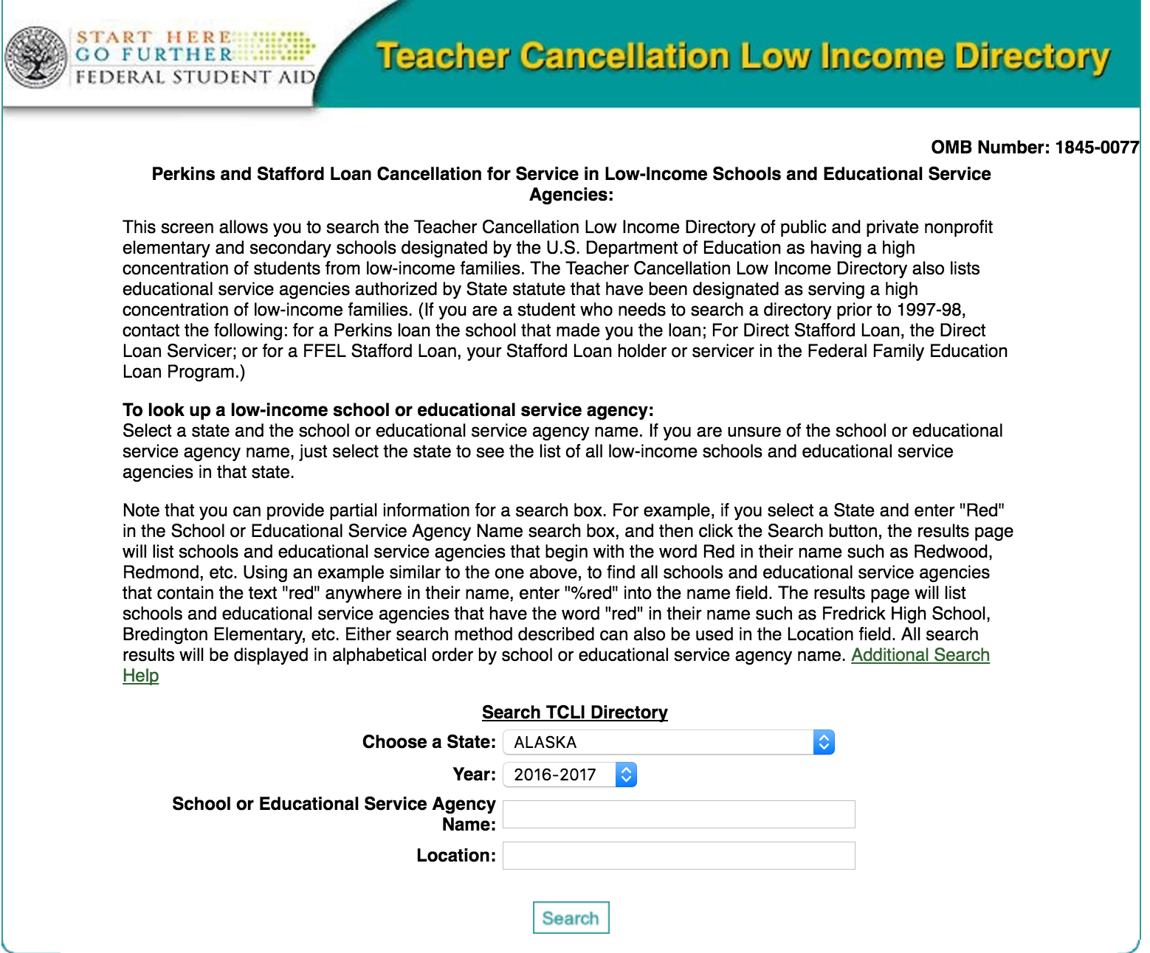
Teacher Cancellation Low Income Directory
https://www.tcli.ed.gov/CBSWebApp/tcli/TCLIPubSchoolSearch.jsp

