Slide 1

Effect Size & Power Analysis + G*Power
Office of Methodological & Data Sciences
November 13, 2015
Sarah Schwartz
www.cehs.usu.edu/research/omds

Slide 2
Quantitative Research
Research Question
Clear, focused & concise question that drives the study
Contains variables and relationships being tested
The Hypothesis
Prediction of relationship(s) among variables
“alternate hypothesis” or H₁
What’s being tested DOES have an effect
Null Hypothesis (implied) or H₀
There is NO RELATIONSHIP between variables being tested
ANY observed relationship was due to CHANGE

Slide 3


Education Example
Research Question
Do early elementary students experience a ‘summer-slide’ in reading achievement?
Alternate Hypothesis (H₁)
Early elementary students DO experience a ‘summer-slide’ in reading achievement.
Null Hypothesis (H₀)
Any decrease in reading achievement of early elementary students over the summer is just do to random chance.

Slide 4
Statistical Inference
After we have selected a sample, we know the responses of the individuals in the sample. However, the reason for taking the sample is to infer from that data some conclusion about the wider population represented by the sample.
Statistical inference provides methods for drawing conclusions about a population from sample data.
Population
Sample
1. Collect data from a representative Sample...
2. Make an Inference about the Population.

Slide 5
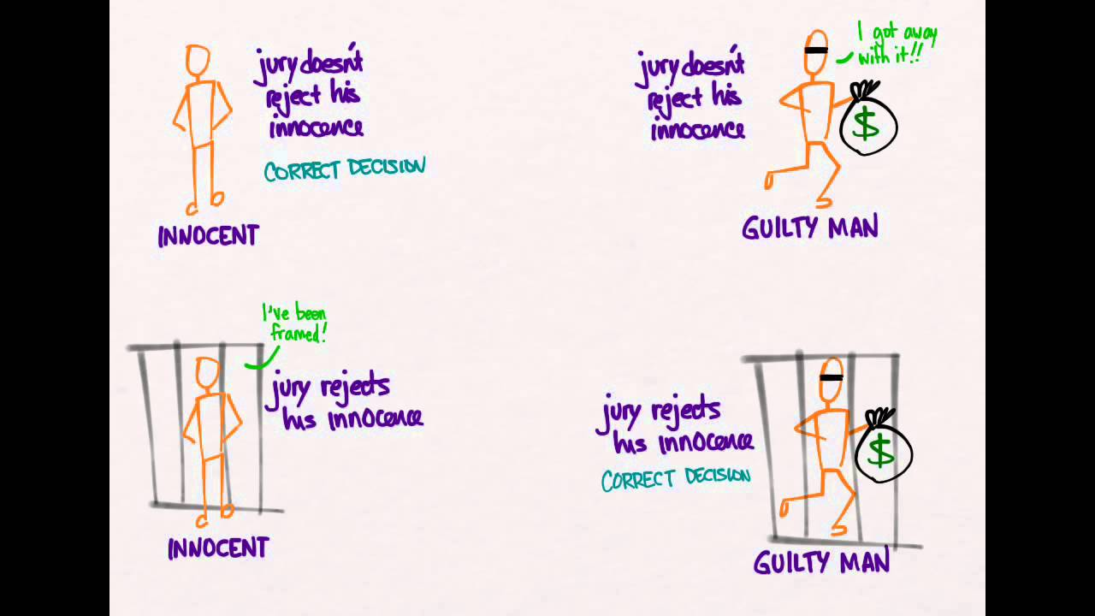
TRUTH
“Innocent
Until proven
Guilty”
INNOCENT GUILTY
Type II Error
CONVICT FAIL to CONVICT
VERDICT
Type I Error

Slide 6
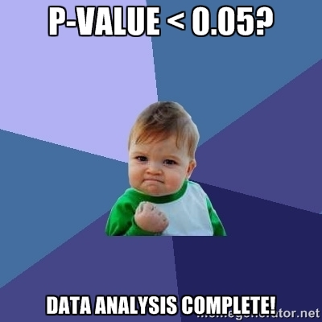
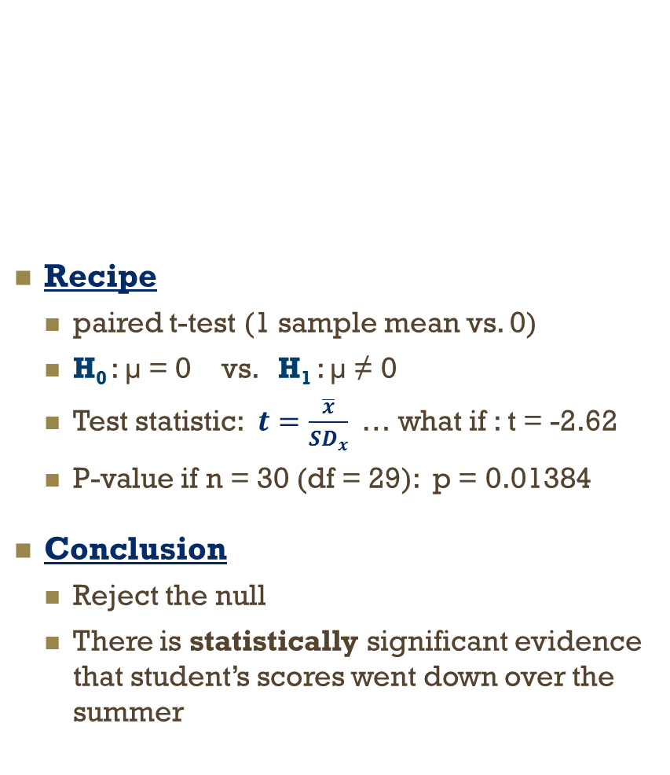
Education Example
Recipe
paired t-test (1 sample mean vs. 0)
H₀ : µ = 0 vs. H₁ : µ ≠ 0
Test statistic: $t=\frac{\overline{x}}{{SD}_{x}}$… what if : t = -2.62
P-value if n = 30 (df = 29): p = 0.01384
Conclusion
Reject the null
There is statistically significant evidence that student’s scores went down over the summer
Name | End K | Beg 1st | Change
Molly | 10 | 9 | -1
Joe | 5 | 6 | +1
Zoey | 9 | 9 | 0
George | 12 | 10 | -2
Null Hypothesis (H₀)
Any decrease in reading achievement of early elementary students over the summer is just do to random chance.
Alternate Hypothesis (H₁)
Early elementary students DO experience a ‘summer-slide’ in reading achievement.

Slide 7
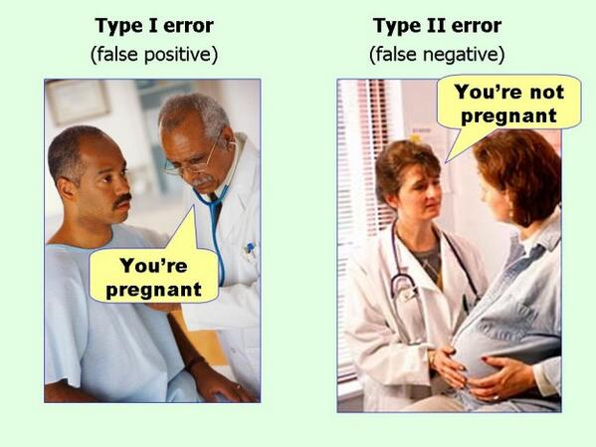
Type I Error
Type II Error
False Positive
Conclude: there IS a relationship
Truth: no relationship, differences just due to random chance
Probability = α
False Negative
Conclude: there is NOT a relationship
Truth: there IS a relationship
Probability = β

Slide 8
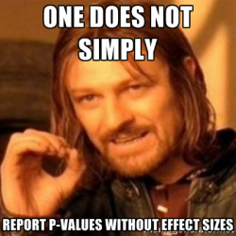
Education Example
Name | End K | Beg 1st | Change
Molly | 10 | 9 | -1
Joe | 5 | 6 | +1
Zoey | 9 | 9 | 0
George | 12 | 10 | -2
Conclusion
Students reading scores went down over the summer.
What type of error could we have made?
Type I ?
Not this time…we are saying there IS a relationship between time and score (scores went down over time)
Type II ?
Possibly…we are claiming there is a relationship…but we can never the 100% sure this sample wasn’t peculiar
What else do you want to know?
By HOW MUCH did the scores go down?
Was the decrease of any PRACTICAL significance?

Slide 9

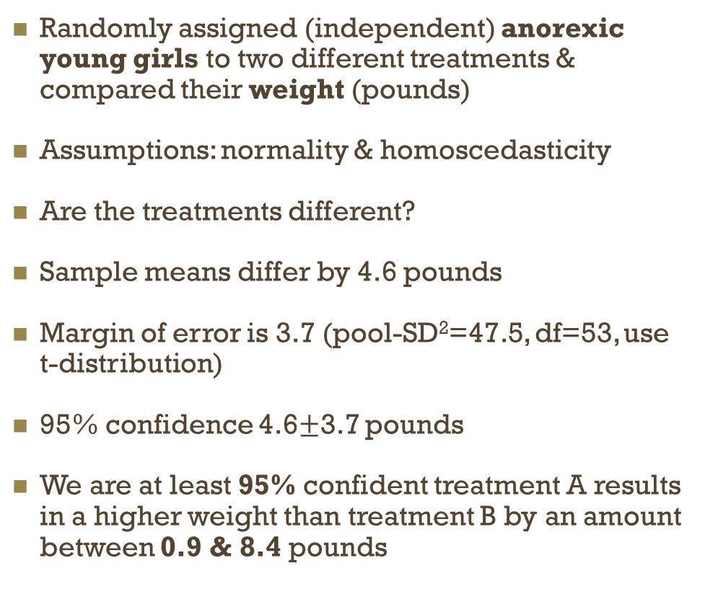
Confidence Intervals
$$d= \frac{μ_{1}−μ_{2}}{σ}$$
Comparing the Averages of 2 Groups
Randomly assigned (independent) anorexic young girls to two different treatments & compared their weight (pounds)
Assumptions: normality & homoscedasticity
Are the treatments different?
Sample means differ by 4.6 pounds
Margin of error is 3.7 (pool-SD²=47.5, df=53, use t-distribution)
95% confidence 4.6$±$3.7 pounds
We are at least 95% confident treatment A results in a higher weight than treatment B by an amount between 0.9 & 8.4 pounds
 | Treatment
 | A | B
N | 29 | 26
M | 85.7 | 81.1
SD² | 69.8 | 22.5

Slide 10
4 Categories of Effect Sizes
Group Differences Indices
Magnitude of difference(s) between 2+ groups
Cohen’s d
Strength of Association
Magnitude of shared variance between 2+ variables
Pearson’s r
Corrected Estimates
Correct for sampling error because of smaller sample sizes
adjusted R²
Risk Estimates
Compare relative risk for an outcome between 2+ groups
Odds Ratio (OR)

Slide 11
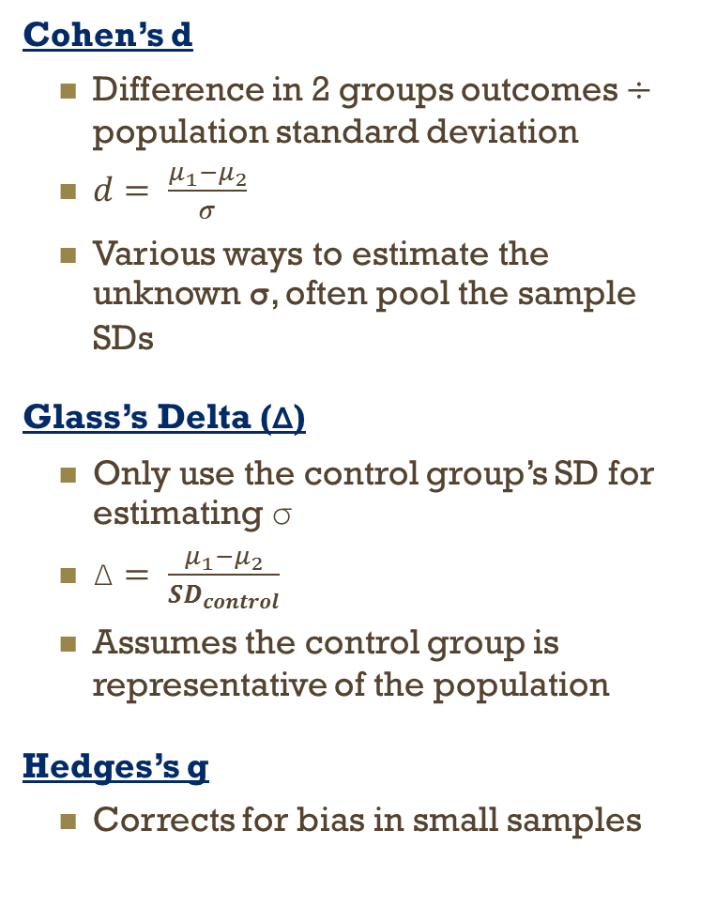

Group Differences
Cohen’s d
Difference in 2 groups outcomes $÷$ population standard deviation
$d= \frac{μ_{1}−μ_{2}}{σ}$
Various ways to estimate the unknown σ, often pool the sample SDs
Glass’s Delta (Δ)
Only use the control group’s SD for estimating σ
$\text{Δ}= \frac{μ_{1}−μ_{2}}{{SD}_{control}}$
Assumes the control group is representative of the population
Hedges’s g
Corrects for bias in small samples
Categorical or Experimental outcomes
General Form:
Common: d, Δ, g
NOTE: social sciences often yield small effect sizes, but small effect sizes can have large practical significance
$$\frac{μ_{1}−μ_{2}}{σ}$$
Effect | value
Minimal | 0.41
Moderate | 1.15
Strong | 2.70

Slide 13
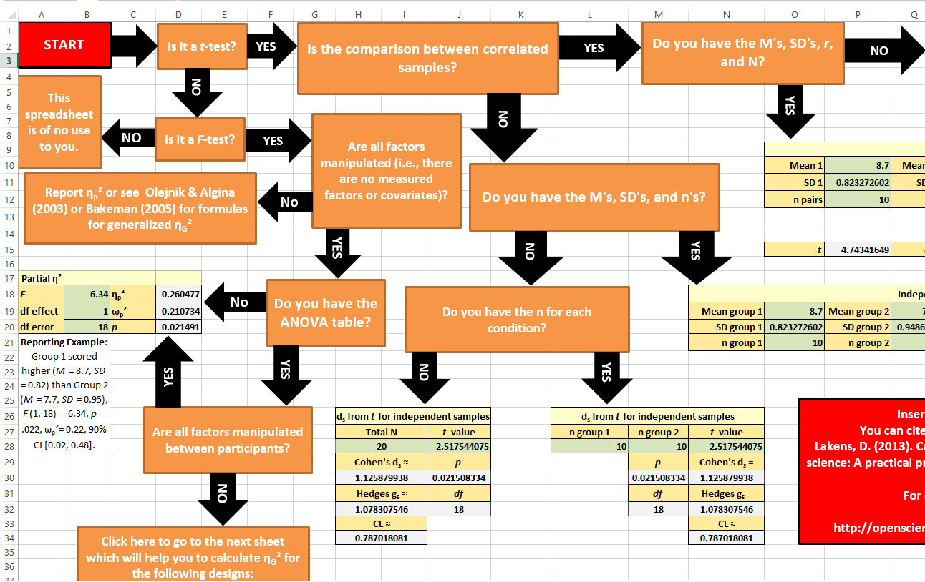
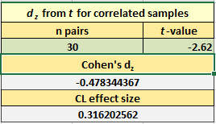
Education Example
Great article: t-tests & ANOVAS
Calculating and reporting effect sizes to facilitate cumulative science: a practical primer for t-tests and ANOVAs
http://journal.frontiersin.org/article/10.3389/fpsyg.2013.00863/abstract
Excel Flow Chart & Calculator
Calculating_Effect_Sizes.xlsx
https://osf.io/vbdah
paired t-test
n = 30 students
t = -2.62
There is statistically significant evidence that student’s scores went down over the summer
What is Cohen’s d???

Slide 14
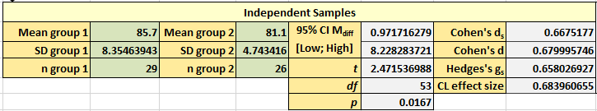
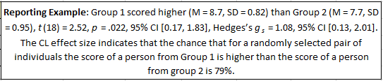
Cohen’s d
$$d= \frac{μ_{1}−μ_{2}}{σ}$$
Comparing the Averages of 2 Groups
Randomly assigned (independent) anorexic young girls to two different treatments & compared their weight (pounds)
Assumptions: normality & homoscedasticity
Are the treatments different?
Sample means differ by 4.6 pounds
Remember: pool SD²=47.5
Cohen’s d = 4.6/√47.5 = 0.67
The standardized mean difference (SMD) between the two treatments is 0.67.
 | Treatment
 | A | B
N | 29 | 26
M | 85.7 | 81.1
SD² | 69.8 | 22.5

Slide 15
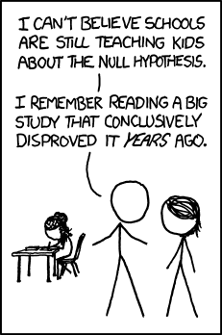
Considerations
Recipe
The type of statistical analysis or comparison being done
Ingredients
Significance Level
α
Probability of making a type I error
Probability of rejecting a TRUE H₀
0.05 is the most used (default)
Power
1- β
Probability of correctly rejecting H₀
0.80 is acceptable standard
Effect Size
How large/strong is the relationship
Degree to which H₀ is false
Sample Size
How many subjects are in the sample(s)
It is IMPOSIBLE to know for SURE if an error has been made…
But we can control the LIKELIHOOD of making an error

Slide 16
Allows for Meta-analysis
Assume the NULL hypothesis is true
Plan the sample size of a new study
Recipe
Significance Level
Power
Effect Size
Sample Size
Effect Size Reporting
A Priori
Power Analysis
Relates the Magnitude of the Relationship or Practical Significance
(resistant to sample size)
Assume the ALTERNATIVE hypothesis is true

Slide 17

Power Analysis
A process for determining the sample size needed for a research study
In most cases, power analysis involves a number of simplifying assumptions, in order to make the problem tractable, and running the analyses numerous times with different variations to cover all of the contingencies.
G*Power
Free software for power analysis
free for bothh PC & Mac
http://www.gpower.hhu.de/

Slide 18
G*Power
A priori
Power analysis for two-group independent sample t-test
A clinical dietician wants to compare two different diets, A and B, for diabetic patients. She hypothesizes that diet A (Group 1) will be better than diet B (Group 2), in terms of lower blood glucose.
She plans to get a random sample of diabetic patients and randomly assign them to one of the two diets. At the end of the experiment, which lasts 6 weeks, a fasting blood glucose test will be conducted on each patient.
She also expects that the average difference in blood glucose measure between the two group will be about 10 mg/dl.
Furthermore, she also assumes the standard deviation of blood glucose distribution for diet A to be 15 and the standard deviation for diet B to be 17.
The dietician wants to know the number of subjects needed in each group assuming equal sized groups.

Slide 19
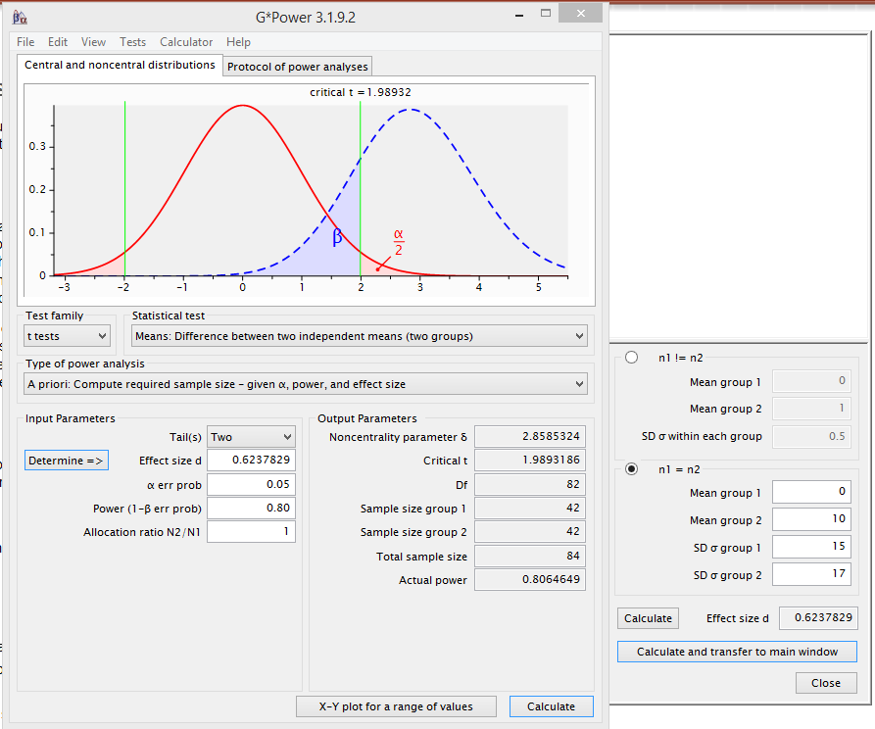
G*Power
Power analysis for two-group independent sample t-test
4 Ingredients | Value
Significance Level | 0.05 (two tails)
Power | 0.80
Effect Size | Diff mean = 10 SE’s = 15 & 17
Sample Size | ??? (2 = sizes)

Slide 20
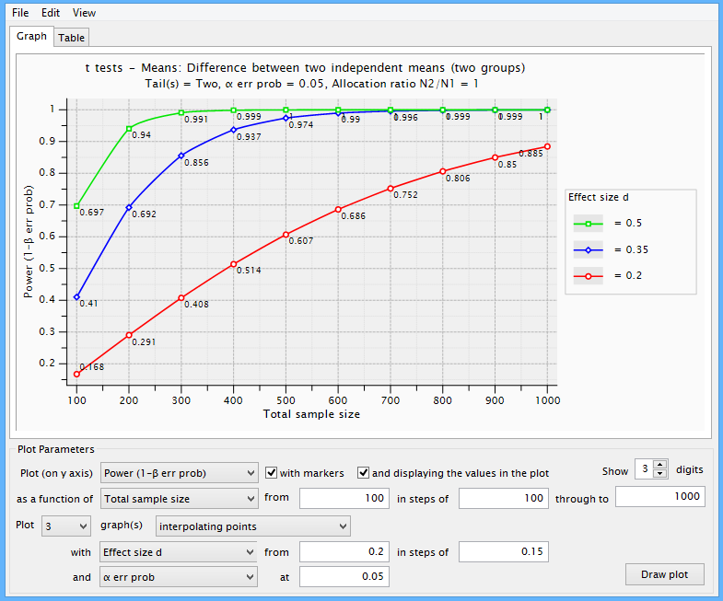
G*Power
Power analysis for two-group independent sample t-test
The clinical dietician is concerned the difference in means might not be as large as she initially thought.
Re-calculate the sample size needed for effect sizes that are lower (0.20 = 0.50).
4 Ingredients | Value
Significance Level | 0.05 (two tails)
Power | 0.80
Effect Size | Diff mean = 10 SE’s = 15 & 17
Sample Size | ??? (2 = sizes)

Slide 21
G*Power
Post Hoc
Power analysis for two-group independent sample t-test
An audiologist wanted to study the effect of gender on the response time to a certain sound frequency.
He suspected that men were better at detecting this type of sound then were women.
He took a random sample of 20 male and 20 female subjects for this experiment. Each subject was be given a button to press when he/she heard the sound.
The audiologist then measured the response time - the time between the sound was emitted and the time the button was pressed.
Males did have a faster mean time (5.1 vs. 5.6), but his results were not statistically significant due to the high variability (SD = 0.8 for males and 0.5 for females)
Now, he wants to know what the statistical power was based on his total of 40 subjects to detect the gender difference.

Slide 22
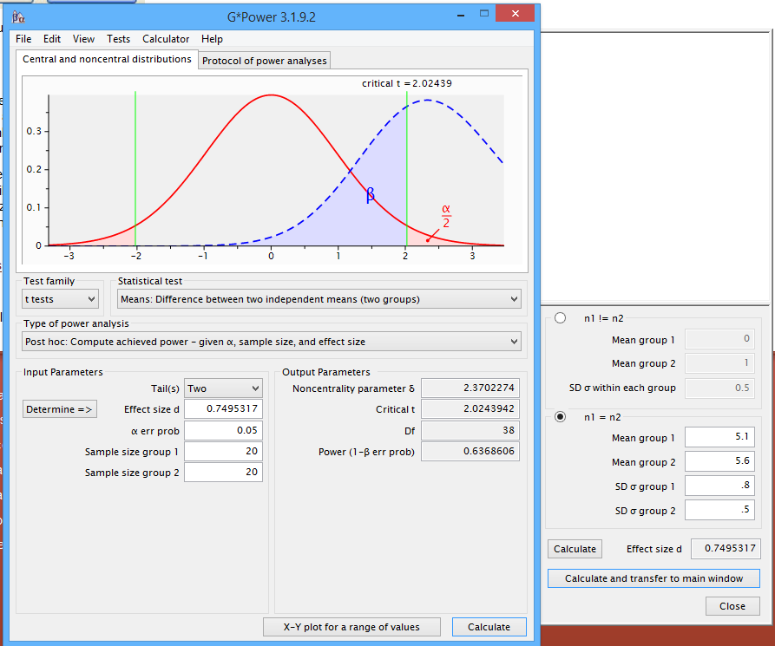
G*Power
Power analysis for two-group independent sample t-test
4 Ingredients | Value
Significance Level | 0.05 (two tails)
Power | ???
Effect Size | Means: 5.1 & 5.6 SDs = 0.8 & 0.5
Sample Size | 20 & 20

Slide 23
G*Power
A priori
Power analysis for 4-group one-way ANOVA
We wish to conduct a study in the area of mathematics education involving different teaching methods to improve standardized math scores in local classrooms. The study will include four different teaching methods and use fourth grade students who are randomly sampled from a large urban school district and are then random assigned to the four different teaching methods: (1) traditional, (2) intensive practice, (3) computer assisted, & (4) peer assistance.
Students will stay in their math learning groups for an entire academic year. At the end of the Spring semester all students will take the Multiple Math Proficiency Inventory (MMPI). This standardized test has a mean for fourth graders of 550 with a standard deviation of 80.
The experiment is designed so that each of the four groups will have the same sample size. One of the important questions we need to answer in designing the study is, how many students will be needed in each group?

Slide 24
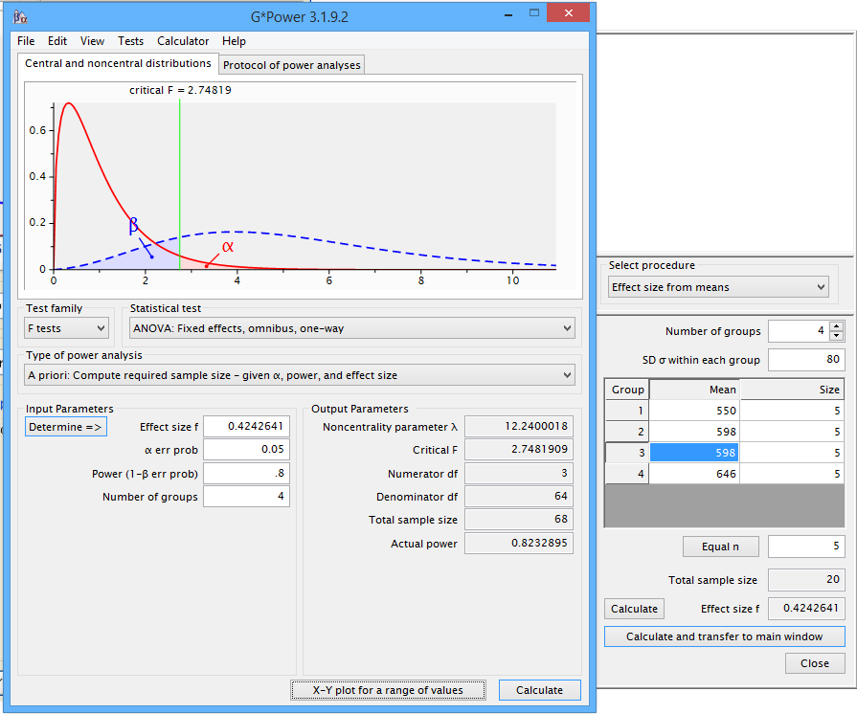
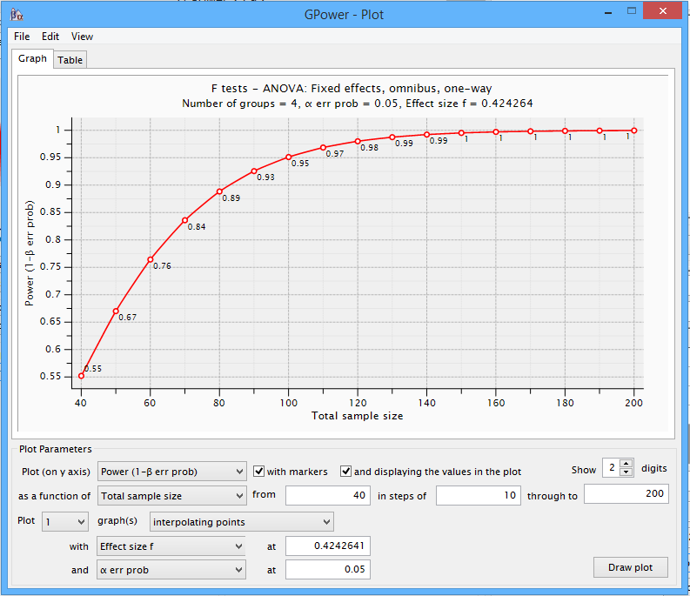
G*Power
Power analysis for 4-group one-way ANOVA
Assumptions & educated guesses:
All 4 groups will have SD = 80
group (1) will have national mean, M = 550
group (4) 1.2*SD higher mean, M = 646
Groups (2) & (3) will fall in the middle M= 550+646/2 = 598

Slide 25
G*Power
Power analysis WARNINGS!
Sample size calculation are based on assumptions
Normal distribution in each group (skewness & outliers cause trouble)
All groups have the same common variance.
Knowledge of the magnitude of effect we are going to detect
When in doubt, use more conservative estimates.
Example: We might not have a good idea on the two means for the two middle groups, then setting them to be the grand mean is more conservative than setting them to be something arbitrary.

Slide 26
Strength of Association
Pearson’s r
Degree of shared variance between 2 variables
Assumes both variables are continuous
Assumes a bi-variable normally distribution
Only measures LINEAR relationship
Point-Biserial Correlation, r_{pb}
One variable it truly a dichotomous variable (not dichotomized split) & the other is continuous
Assumes homoscedasticity (same amount of variation/spear in the two groups)
Calculate Pearson’s r in usual way
Continuous or Correlational Data
r, R, φ, ρ, partial r, β, r_{h}, tau
Squared association indices
r², R², η², adjusted R², ω², ϵ²
Effect | value
Minimal | 0.2
Moderate | 0.5
Strong | 0.8
Effect | value
Minimal | 0.04
Moderate | 0.25
Strong | 0.64

Slide 27
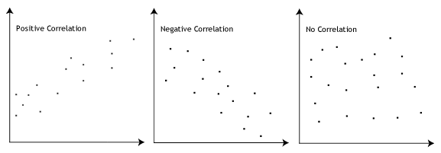
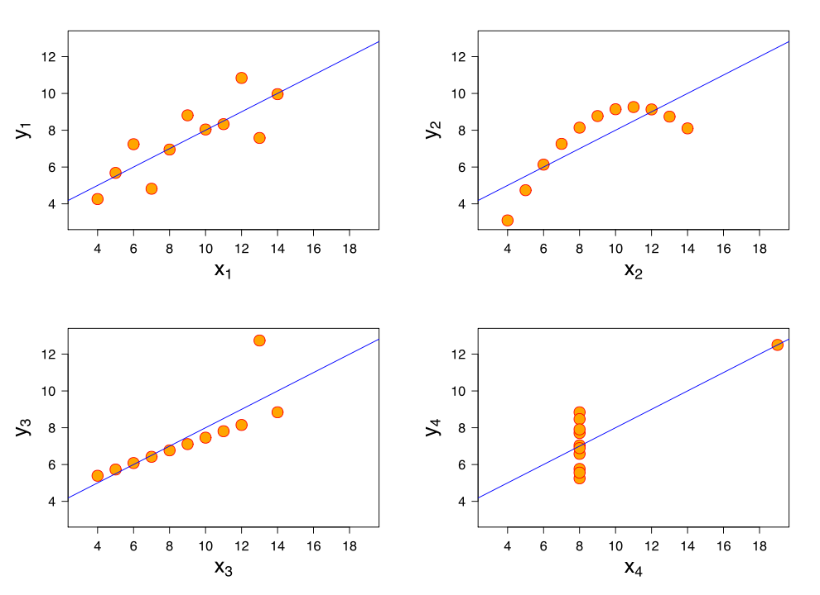
Pearson’s r
LINEAR!

Slide 28
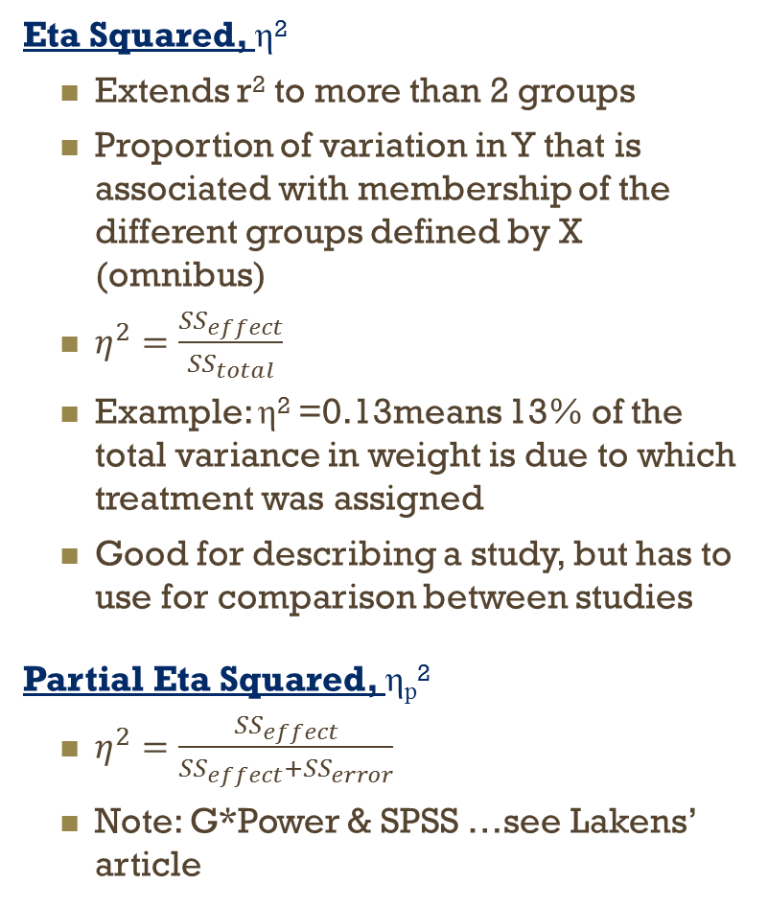
Strength of Association
Eta Squared, η²
Extends r² to more than 2 groups
Proportion of variation in Y that is associated with membership of the different groups defined by X (omnibus)
$η^{2}=\frac{{SS}_{effect}}{{SS}_{total}}$
Example: η² =0.13means 13% of the total variance in weight is due to which treatment was assigned
Good for describing a study, but has to use for comparison between studies
Partial Eta Squared, η_{p}²
$η^{2}=\frac{{SS}_{effect}}{{SS}_{effect}+{SS}_{error}}$
Note: G*Power & SPSS …see Lakens’ article
Continuous or Correlational Data
r, R, φ, ρ, partial r, β, r_{h}, tau
Squared association indices
r², R², η², adjusted R², ω², ϵ²
Effect | value
Minimal | 0.2
Moderate | 0.5
Strong | 0.8
Effect | value
Minimal | 0.04
Moderate | 0.25
Strong | 0.64

Slide 29
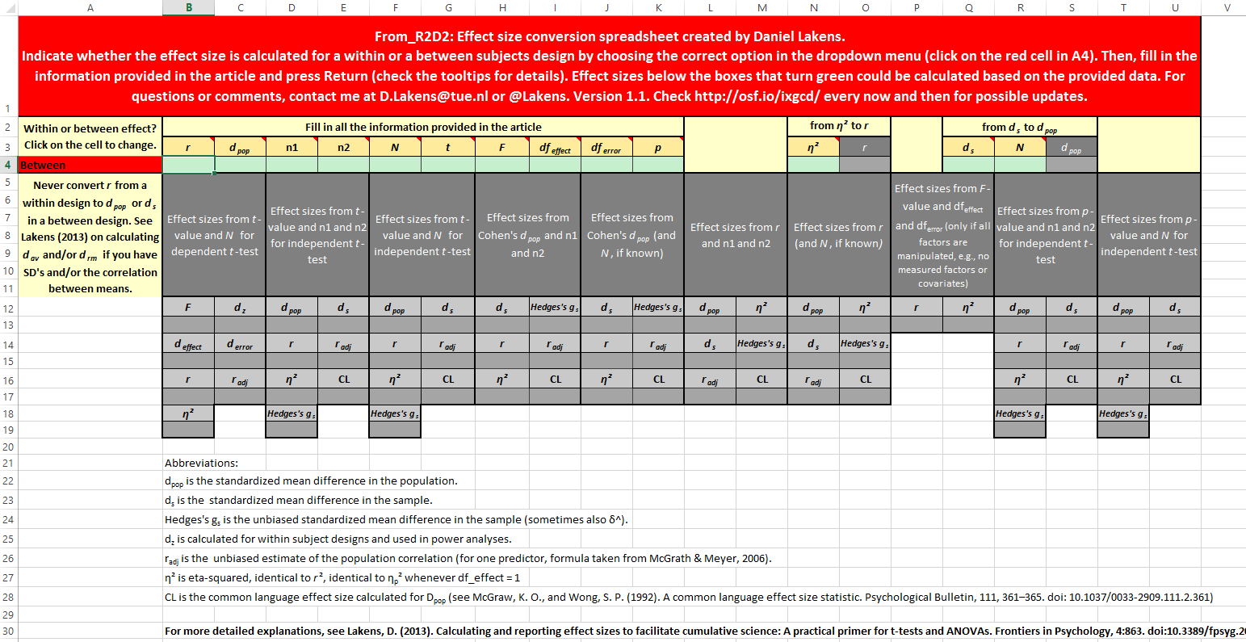
Differences & Similarities Between Effect Sizes
Excel Effect Size Conversions
From_R2D2.xlsx
https://osf.io/vbdah

Slide 30
G*Power
A priori
Power analysis for multiple regression
A school district is designing a multiple regression study looking at the effect of factors on the English language proficiency scores of Latino high school students.
Gender & family income: control variables and not of primary research interest
Mother's education: continuous variable: number of years (4 to 20) that the mother attended school
Language spoken in the home (homelang): categorical research variable with three levels: (1) Spanish only, (2) both Spanish and English, and (3) English only. Since there are three levels, it will take two dummy variables
Full regression model:
Presearch hypotheses are the test of b₃ and the joint test of b₄ and b₅.
These tests are equivalent the testing the change in R² when momeduc (or homelang1 and homelang2) are added last to the regression equation.
$$engprof= β_{0}+β_{1}∗sex+β_{2}∗income+β_{3}∗mom+β_{4}∗lang1+β_{5}∗lang2$$

Slide 31
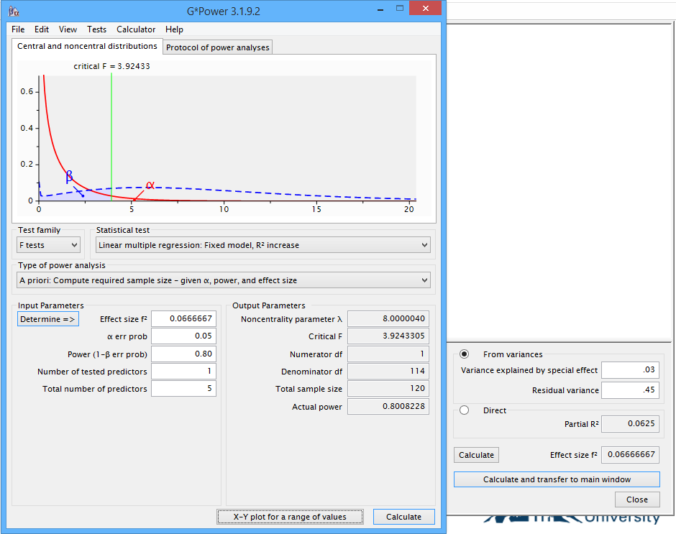
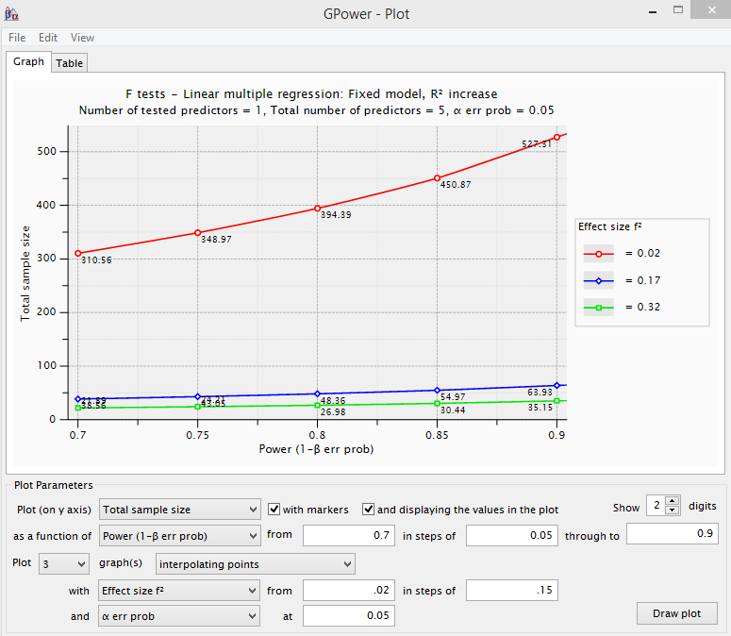
G*Power
A priori
To begin, the program should be set to the F family of tests, to a Special Multiple Regression, and to the 'A Priori' power analysis necessary to identify sample size.
Start with mom’s education
We expect full model to account for about 45% of the variation in language proficiency

Slide 32
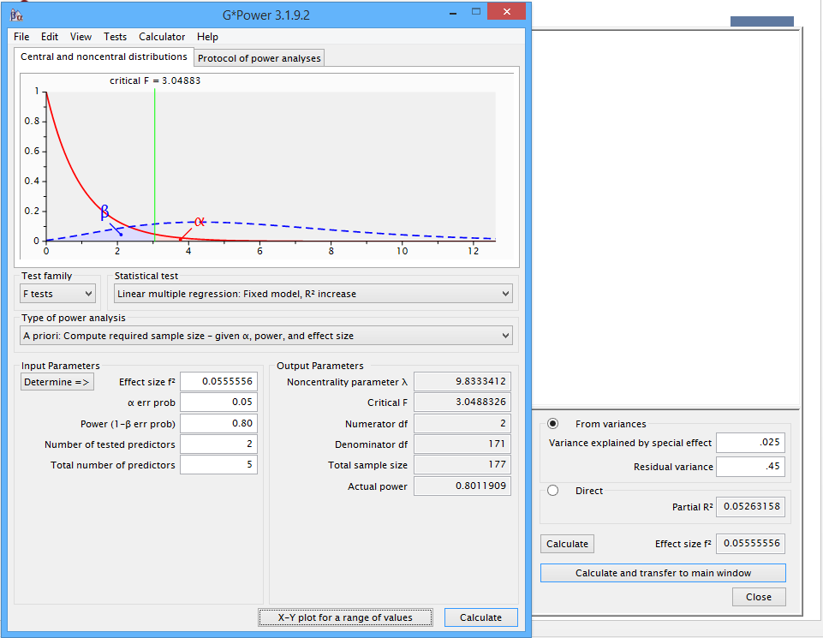
G*Power
A priori
To begin, the program should be set to the F family of tests, to a Special Multiple Regression, and to the 'A Priori' power analysis necessary to identify sample size.
Move on to 2 variables that code for language

Slide 33
G*Power
Control for MULTIPLE COMARISONS…investigating multiple things
If BOTH of these research variables are important, we might want to take into that we are testing two separate hypotheses (one for the continuous and one for the categorical) by adjusting the alpha level.
The simplest but most draconian method would be to use a Bonferroni adjustment by dividing the nominal alpha level, 0.05, by the number of hypotheses, 2, yielding an alpha of 0.025.
The Bonferroni adjustment assumes that the tests of the two hypotheses are independent which is, in fact, not the case.
The squared correlation between the two sets of predictors is about .2 which is equivalent to a correlation of approximately .45.
Using an internet applet to compute a Bonferroni adjusted alpha taking into account the correlation gives us an adjusted alpha value of 0.034 to use in the power analysis.

